Slide 1
UML State Machine Model
(Lect 7)

Slide 2
State Chart Diagram
  FSMs suffer from a few severe shortcomings:
    What are the shortcomings of FSM?
State chart is based on the work of David Harel [1990]:
  Overcomes important shortcomings of FSM
    Extends FSM in 2 major ways: Concurrent states and hierarchy.

Slide 3

Robot: State Variables
Power: On, OFF
Movement: Walk, Run
Direction: Forward, Backward, left, Right
Left hand: Raised, Down
Right hand: Raised, down
Head: Straight, turned left, turned right
Headlight: On, Off
Turn: Left, Right, Straight
How many states in the state machine model?
FSM: exponential rise in number of states with state variables

Slide 4
Event | State
turnOn | Activated
turnOff | Deactivated (Idle)
stop | Stopped
walk | Walking
run | Running
raiseLeftArm | LeftArmRaised
lowerLeftArm | LeftArmLowered
lowerLeftArm | LeftArmLowered
raiseRightArm | RightArmRaised
lowerRightArm | RightArmLowered
turnHead | HeadTurned(direction)
speak | Talking(text)

Slide 5
State Chart Diagram Cont…
State chart avoids two problems of FSM:
  State explosion
  Lack of support for representing concurrent states
A hierarchical state model:
  Makes use of composite states --- OR and AND states.

Slide 6
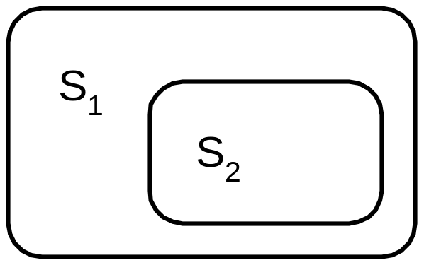
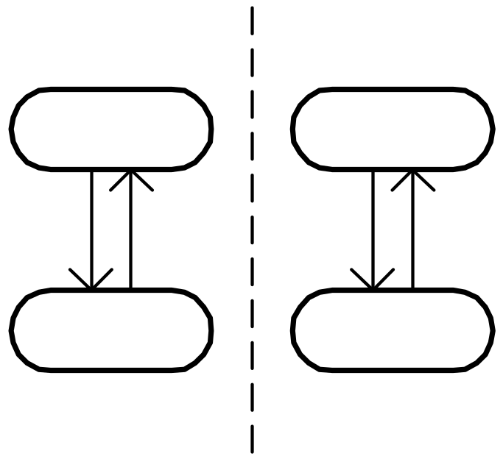
Features of State Charts
Two major features introduced :
  Nested states
  Concurrent states
Several other features have also been added:
  History state
  Broadcast messages
  Actions on state entry and exit
  …
Nested State
s11
s21
s12
s22
Concurrent State

Slide 7
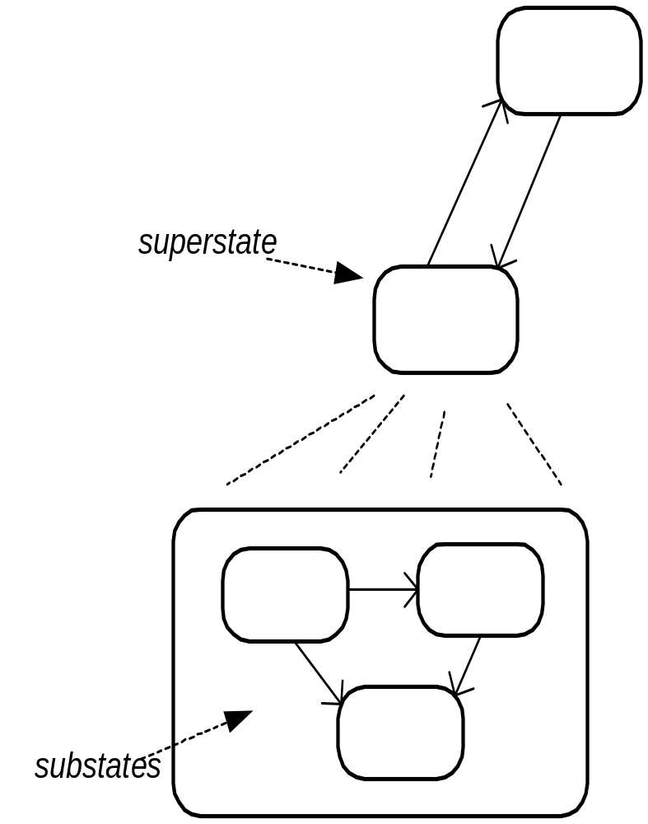
Nested State Diagrams
Hierarchical organization is a classic way to control complexity:
  of programs
  of documentation
  of objects
  …
Why not state diagrams?
  superstates
  substates

Slide 8
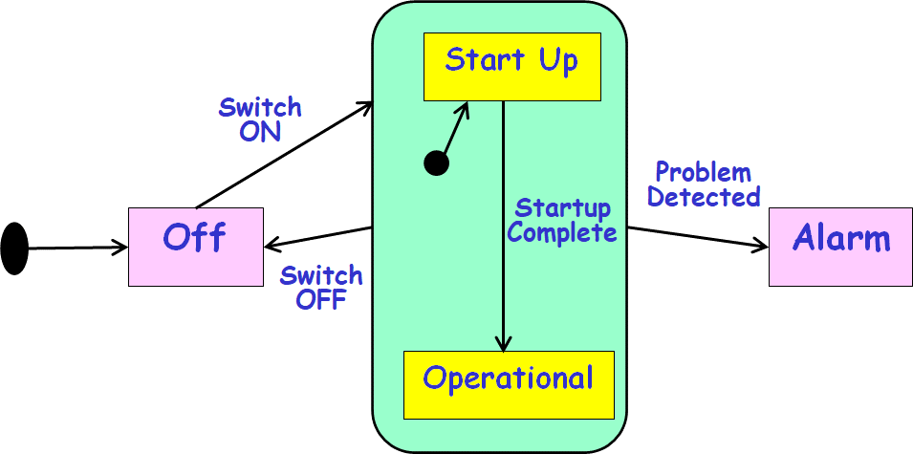
State Chart Diagram
Cont…
Basic elements of state chart diagram:
  Initial State: A filled circle
  Final State: A filled circle inside a larger circle
  State: Rectangle with rounded corners
  Transitions: Arrow between states, also boolean logic condition (guard)‏
State chart in UML is called state machine:
  As it not only models state behavior but also generates code…
Off
Alarm

Slide 9
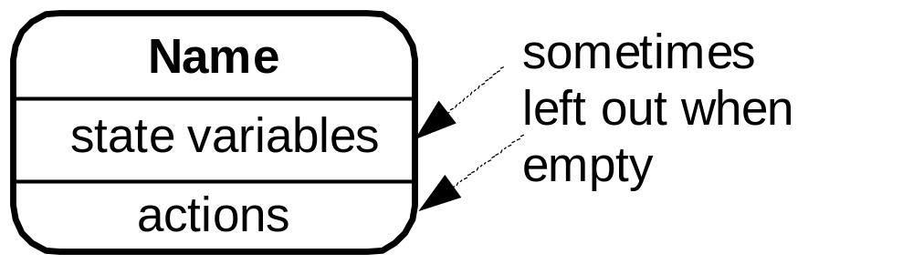
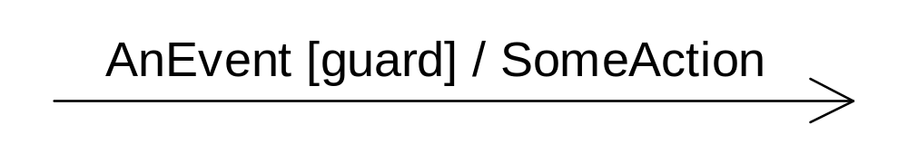
UML State Machine Diagram: Syntax
A state is drawn with a round box, with three compartments for:
  name
  state variables
  actions performed
A transition is drawn with a labeled arrow,
  event causing the transaction
  guard condition
  Action to perform

Slide 10


Slide 11
Syntax of UML State machine
State: Rectangle with rounded corners
Name tab
Action label:
  Entry
  Exit
  Do
Typing password
Entry/ set echo invisible
Exit / set echo normal
Do / read character

Slide 12
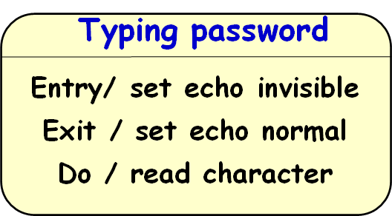
Predefined Action Labels
“entry/”
  Identifies an action to be performed upon entry to the state
“exit/”
  Identifies an action to be performed upon exit from the state (exit action)
“do/”
  Identifies an ongoing activity (“do activity”) that is performed as long as the modeled element is in the state or until the computation specified by the action expression is completed

Slide 13
“Do” Activities
The thread executes until:
  The action completes or
  The state is exited through an outgoing transition
Error
“do” activity
entry/printf(“error!”)
do/while (true) alarm.ring();

Slide 14
Basic UML State Model Syntax
“top” state
State
Initial
pseudostate
Top
Trigger
Ready
Transition
stop
/ctr = 0
Done
Final
state
Action
stop

Slide 15
Guards
Boolean predicates to indicate Conditional execution of transitions
bid [value < 100] /reject
Selling
Happy
bid [value >= 200] /sell
bid [(value >= 100) & (value < 200)] /sell
Unhappy

Slide 16
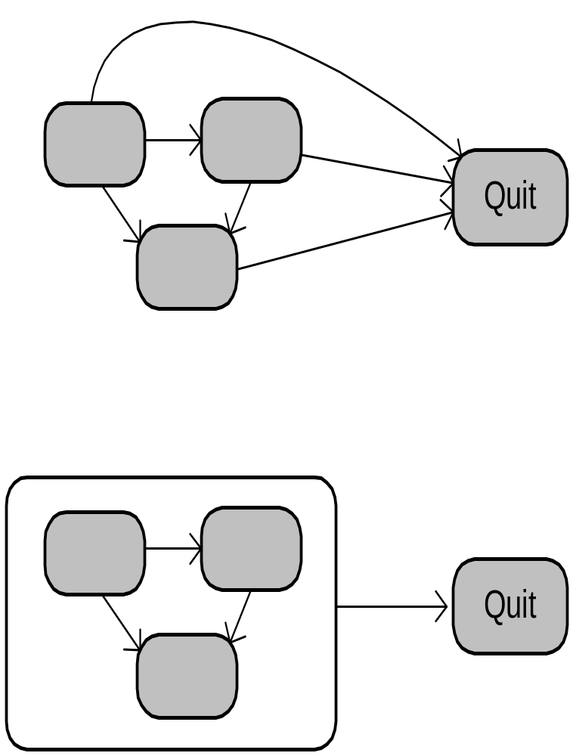
Eliminating Duplicated Transitions
Duplicate transitions usually exist when some transition can happen from every state:
  “error”
  “quit”
  “abort”
These duplicates can be combined into a single transition:
  A transition from a superstate holds for all of its substates!

Slide 17
Hierarchical State Machines
Replace transition from every substate by a single transition from superstate…
LampOff
LampFlashing
flash/
entry/lamp.off()
FlashOn
off/
entry/lamp.on()
1sec/
1sec/
on/
on/
FlashOff
on/
LampOn
entry/lamp.off()
entry/lamp.on()

Slide 18
Group Transitions
Higher-level transitions
Default transition to
the initial pseudostate
LampOff
flash/
LampFlashing
entry/lamp.off()
FlashOn
off/
entry/lamp.on()
1sec/
1sec/
on/
FlashOff
on/
LampOn
entry/lamp.off()
entry/lamp.on()
Group transition

Slide 19
Completion Transitions
Triggered by a completion event:
  Generated automatically when an immediately nested state machine terminates.
completion
transition (no trigger)
Committing
Phase1
CommitDone
Phase2

Slide 20
A Heart Monitor Application: Convert to Hierarchical State Machine
Start Up
Problem Detected
Switch
ON
Switch OFF
Off
Startup Complete
Alarm
Switch OFF
Problem Detected
Operational

Slide 21
The Heart Monitor Revisited
Start Up
Transition from
Super state
Switch
ON
Startup Complete
Problem Detected
Off
Alarm
Switch OFF
Operational

Slide 22


Slide 23
Full Diagram for Heart Monitor Applications
Quiz: Convert Using OR-State…
The number of states and transitions have grown quickly
StartUp Battery
Start Up Mains
Alarm Battery
Off
Alarm Mains
Operational Battery
Why do the states and transitions grow fast?
Operational mains

Slide 24
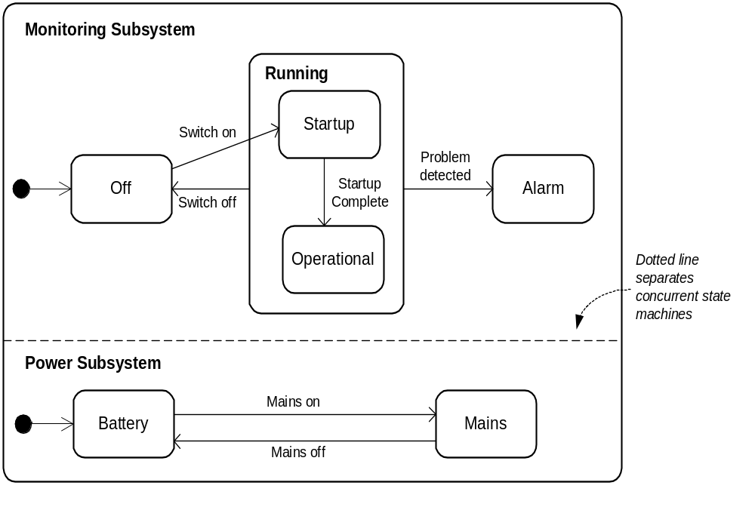
Heart Monitor as Concurrent State Machine

Slide 25
Introducing Hierarchy
f
g
h
i
j
A
B
C
D
E
k
k
k
k
k
m
Z
super-state S
S
f
A
g
B
h
C
i
D
j
E
k
m
Z
sub-states

Slide 26
Dialling
Basic Composite State: OR state
Start
entry/start dial tone
exit/stop dial tone
digit(n)
Encode

Slide 27
Composite State: AND State
Composite states can have:
– concurrent substates -and- relationship
• substate separated from others by dotted line
– disjoint substates -or- relationship
• transitions between substates
Overhead Projector
On Desk
Light Off
On Floor
Light On

Slide 28
Exercise 1: Develop State Machine Model
In a chess game:
  Black and white sides take turn to play.
The game ends anytime when:
  Either there is a checkmate, or
  There is a stalemate.

Slide 29
Chess
White’s
turn
stalemate
white moves
black moves
checkmate
Black’s turn

Slide 30
Handling Interrupted States
Sometimes it is necessary to interrupt a complicated procedure:
  And then resume exactly from where you stopped
Consider installing a program on your computer
  “Out of memory: please delete some files and hit continue”
In many situations a normal course of processing is interrupted and then resumed
  How can this be handled in a nested state diagram?

Slide 31
History
Return to a previously visited hierarchical state.
Diagnosing
suspend/
Diagnostic1
Diagnostic2
Step11
Step21
resume/
Step12
Step22
H*

Slide 32

Orthogonality
Multiple simultaneous perspectives on the same entity.
age
financialStatus
Child
Poor
Adult
Rich
Retiree

Slide 33
Orthogonal Regions
Combine multiple simultaneous descriptions
age
financialStatus
Child
Poor
Adult
age
financialStatus
Child
Rich
Retiree
Poor
Adult
Retiree
Rich

Slide 34
Orthogonal Regions - Semantics
All mutually orthogonal regions detect the same events and respond to them “simultaneously”
  Usually reduces to interleaving of some kind.
Person
legalStatus
financialStatus
LawAbiding
Poor
robBank/
robBank/
Outlaw
Rich

Slide 35
Common Misuse of Orthogonality
Using regions to model independent objects
Person1
Person2
Person1
Person2
Child
Child
Adult
Adult
Retiree
Retiree

Slide 36
Exercise : Simple Elevator System (Partial)
The elevator is by default at the ground floor.
When idle and a button at the same or a higher floor is pressed:
  It moves up when button at any upper floor is pressed and halts when the requesting floor is reached.
When idle and a button at the same or a lower floor is pressed:
  It moves down. Halts when requesting floor is reached.
When it is inactive at a floor for more than 10 minutes:
  It moves down to the ground floor.

Slide 37
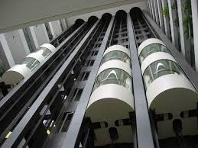
Simple Elevator System
Lift
Call
Lift
Call
Lift
Call
Lift
Call
Lift
Call
Lift
Call
Lift
Call

Slide 38
Elevator: State Machine Representation
On Ground
Floor
[SOH]
Moving
Up
up floor
arrive
at floor
Moving to
Ground Floor
arrive
at floor
up floor
[SOH]
Moving
Down
arrive at floor
Idle
[SOL]
down floor
time-out
SOH: Lift at same or higher floor

